Slide 1
Peter’s Story from Stribor’s Forest
One evening, a young man whose name was Peter, entered a videogames arcade.
In this place some of the magic was Good and some Bad to each as young people deserved. When Peter entered, he was attracted to a very beautiful girl who was the leader of a bad boys group in the city.

Slide 2
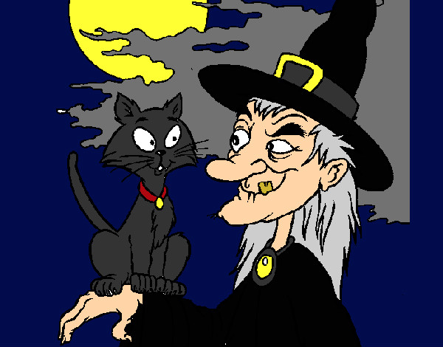
They were boys with a bad reputation. They drank a lot of alcohol and used lots of drugs. They vandalised the city.
Peter liked her and decided to introduce the girl to his mother. Ottavia, that was her name , put on elegant clothes and was kind to Peter’s mother for that occasion. But the old and wise mother understood the real nature of the girl and asked her son to forget her,because she wasn’t good for him. Peter didn’t follow his mother advice and began to hate her and consider her a witch…

Slide 3
Time passed and the young man began to get drunk and behave in the same bad manners of his girl-friend. Every day , the old mother cried and asked God for help. She hoped that he forgot that girl and went back to being a good young man.
Fortunately , one day , a new and nice classmate arrived in Peter’s class , she was very clever at school and had good values.
Her name was Sally.

Slide 4
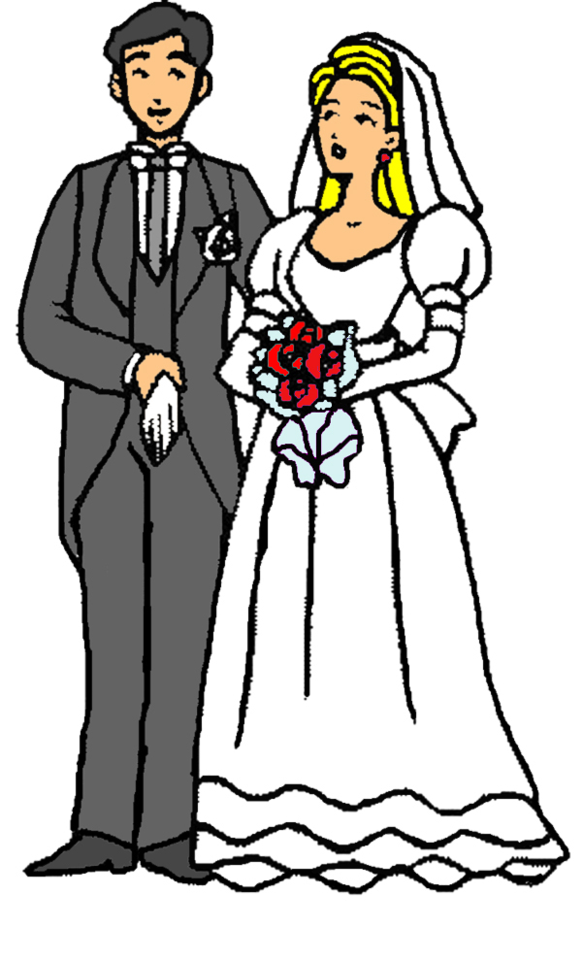
They talked a lot and spent much time together ,not only in the class, but also outside. Peter liked Sally very much. He fell in love with her and left Ottavia .
So Peter and the sweet girl got married and lived together happily and in peace .
The deep message of the story is that GOOD ALWAYS TRIUMPHS OVER EVIL.
Martina Pirozzi – 2^ C

